Slide 1
Unit 3
Productivity Skills with Microsoft 365

Slide 2
5Cs for Success
Coordinate
Comfort
Cooperate
Communicate & Connect
Continue
Notes:
The 5Cs here are based on a presentation done by Morénike Giwa Onaiwu, PhD- https://awnnetwork.org/directory/morenike-giwa-onaiwu/ for the Autism Community Training organization in March 2024.
Coordination
Questions and remarks are welcome
Gender neutral washrooms are located ___________
Sensory or quiet spaces are located ____________
Comfort- Do what you need to be comfortable!
Grab drinks or snacks and take breaks as you need them
Find a comfortable space (floor, various chairs and locations in the space, walking, standing)
Stimming devices and fidgets
Cooperate
Together for a period for a mutual goal, let’s be kind with one another
Be considerate of everyone’s backgrounds and perspectives,
Give people the benefit of the doubt, perceive that people are coming from a neutral place
Communicate and Connect
Share experiences with one another and connect with the material
Make it relevant to your life and interests
Continue
Learning is a process, review materials again later if something doesn’t stick
Ask your instructors to review or repeat

Slide 3
5Cs for Success
Coordination
Questions and remarks are welcome
Gender neutral washrooms are located ___________
Sensory or quiet spaces are located ____________
Comfort- Do what you need to be comfortable!
Grab drinks or snacks and take breaks as you need them
Find a comfortable space (floor, various chairs and locations in the space, walking, standing)
Stimming devices and fidgets
Cooperate
Together for a period for a mutual goal, let’s be kind with one another
Be considerate of everyone’s backgrounds and perspectives,
Give people the benefit of the doubt, perceive that people are coming from a neutral place
Communicate and Connect
Share experiences with one another and connect with the material
Make it relevant to your life and interests
Continue
Learning is a process, review materials again later if something doesn’t stick
Ask your instructors to review or repeat
Notes:
The 5Cs here are based on a presentation done by Morénike Giwa Onaiwu, PhD- https://awnnetwork.org/directory/morenike-giwa-onaiwu/ for the Autism Community Training organization in March 2024.

Slide 4

Your Technology Skills Progress
Windows 10
Microsoft 365
Google Workspace
Data Entry & Cleaning with Excel
Data Wrangling with Power Query
Data Modeling with Power BI
Data Visualization with Power BI
Data Querying with SQL
Notes:
Icon is Christania

Slide 5
Agenda
In this lecture, we are going to focus on…
Time | Topic
 | Movement Break
 | Movement Break

Slide 6
Learning Outcomes
By the end of the lecture, you will be able to…
Explore the Microsoft Word, Excel, PowerPoint and Outlook applications and their file extensions.
Create new files in each of Word, Excel, and PowerPoint from a template.
Experiment with the functions for fonts, themes, layouts, and reviewing in the toolbar.
Experiment with email and calendar features in Outlook.
Use OneDrive for cloud storage and collaboration.

Slide 7
Today is an integrated lecture and lab day!
We will work through the lab exercises together
We will work at a balanced pace
If you are struggling to follow along, just watch for now and do the activities later.
Support each other in learning. Consider setting up study groups.

Slide 8
3.1
Microsoft Office 365

Slide 9

Microsoft Office Suite is a cloud-based collection of productivity applications developed by Microsoft.
This Photo by Unknown Author is licensed under CC BY-NC

Slide 10

Local vs Cloud-based
When you are working with files, application that are physically stored on your computer, you are using them locally.
You can move all these files and application off your computer, onto the internet, you are working in Cloud.
Microsoft Office……
But Online

Slide 11
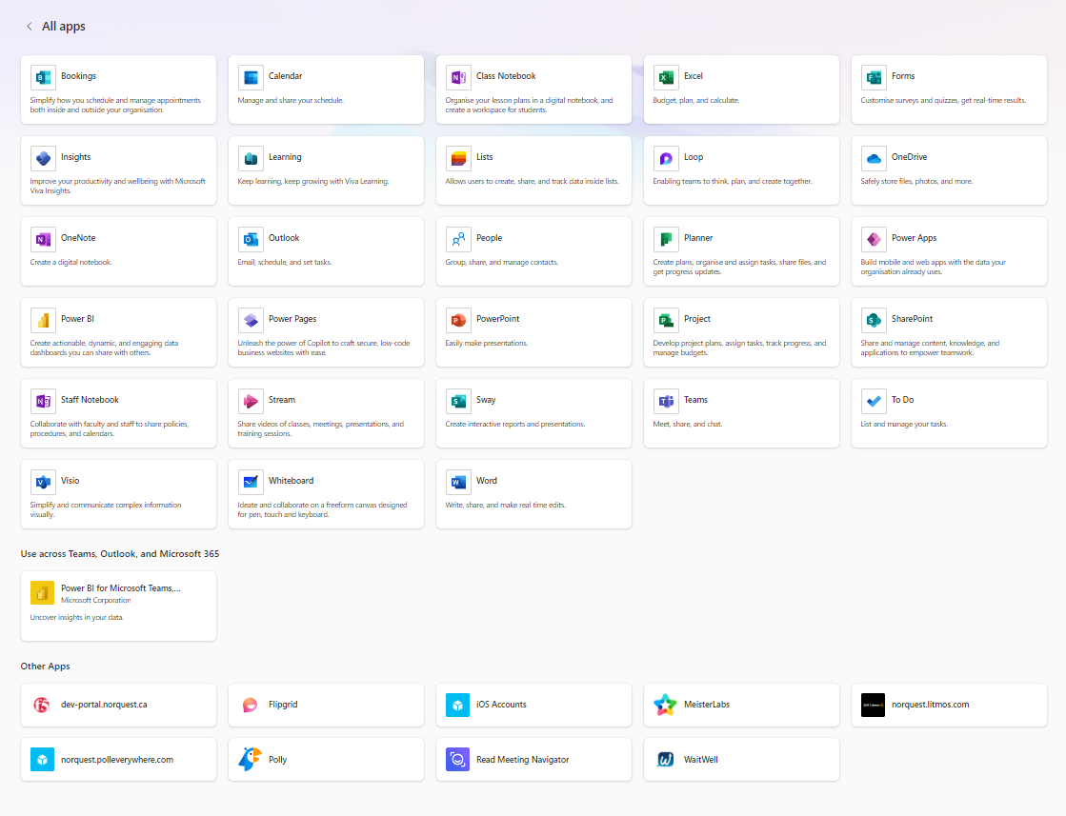
It includes popular tools like Outlook, OneDrive, Word, Excel, and PowerPoint.

Slide 12
And more like Power BI and integration with third-party tools.

Slide 13

Microsoft Outlook
Outlook is an email client and personal information manager.
It allows users to manage emails, calendars, contacts, and tasks efficiently.
File extensions:
.pst (downloaded email items)
.ost (on-server email items)
.ics (Calendar items)
Notes:
https://support.microsoft.com/en-us/office/introduction-to-outlook-data-files-pst-and-ost-222eaf92-a995-45d9-bde2-f331f60e2790

Slide 14
Add additional Outlook content
How to use calendar

Slide 15
Microsoft Teams

Slide 16

Microsoft Word
Word processing software is an essential tool for creating, editing, and formatting text-based documents.
Ideal for writing reports, letters, resumes, and other text-based materials.
Offers a range of design templates.
File extensions:
.docx (Document)
.doc (Legacy Document)

Slide 17

Microsoft PowerPoint
Presentation software designed to create engaging and visually appealing slideshows for various purposes.
It allows users to convey information effectively through multimedia elements, animations, and graphics.
Ideal for business presentations, educational lectures, and sharing ideas.
Offers a range of design templates, animations, and multimedia integration.
File extensions:
.pptx (PowerPoint Presentation)
.ppt (Legacy PowerPoint Presentation)
Notes:
.pptx (PowerPoint Presentation): The default file format for presentations created in PowerPoint.
.ppt (Legacy PowerPoint Presentation): An older file format, compatible with older versions of PowerPoint.
There are also theme and template files.

Slide 18

Microsoft Excel
Spreadsheet software allows users to organize data, create charts, and perform calculations.
It allows users to analyze data and make effective decisions.
Ideal for managing financial data, creating budgets, charts, and graphs.
Provides various formulas, functions, and data manipulation tools.
File extensions:
.xlsx (Excel Workbook)
.xls (Legacy Excel Workbook)
.csv (Comma Separated Values)

Slide 19

Microsoft OneDrive
Microsoft OneDrive is a cloud storage that allows user to store data on the internet.
All you need is a cloud storage account and internet.
Allows users to upload and download data from the it.
It can be accessed from computer, tablets and mobile.
OneDrive allows sharing and collaboration of files from anywhere.

Slide 20
Summary
Microsoft 365 is a set of general software tools used for office productivity tasks like
word processing,
emailing,
scheduling meetings,
making presentations, and more.
Many of the toolbar functions and features are similar between programs for ease of use.

Slide 21
Learning Check In
How well do you know the learning content from today?
Rate yourself.
1
2
3
4
Not Yet
Review
Understand
Use
I don’t understand it all yet
And I may need some support to do it correctly
I understand most of it
But I need to do some review or practice on my own
I understand it
And I can do it
I understand it
I can do it
And I am also ready to try to use it in a new context

Slide 22
What is one thing you think you need to review from today’s learning?
OR
Something you want to find out more about?

